Slide 1
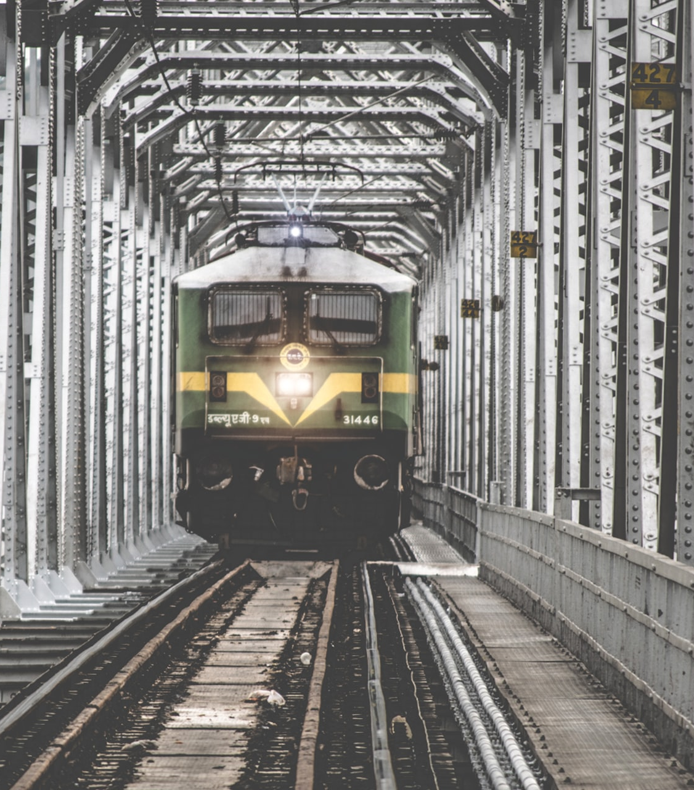
RAILWAY RESERVATION SYSTEM
Submitted by-
ANKIT KUMAR YADAV (2K18/SE/024)
ASHISH KUMAR (2K18/SE/041)

Slide 2
INTRODUCTION
The Railway Reservation System facilitates the customers to enquire about the trains available on the basis of source and destination, for booking and Cancellation of tickets, etc. The purpose of this project is to develop software for railway reservation system with various functional and non- Functional part of design namely,
Book a ticket
Cancel ticket
Viewing train information
Viewing booking details
Updating profiles
And to design and develop databases maintaining the records of different trains, admin, staffs, customers and customer’s booking. Railway reservation system is the computerized system of booking the ticket of train in advanced. In India, there are number of counters for the booking of the seats and one can easily make reservations and get tickets, but online reservation System has made the process for the booking of tickets very much easier than ever before.
We need a digital Railway Reservation System, so this software has to be developed for automating the manual reservation system of Railway.
Limitations in manual RAILWAY RESERVATION SYSTEM are:
It takes more time in processing.
It takes a lot of effort to process and manage.
There are large numbers of customers who book daily for different trains so this work became very hectic which increases chances of errors.
Very difficult to search a particular data.
There is lack of security for data.
Poor maintenance of databases in the long run.
Possibility of errors due to manual processing

Slide 3
Proposed System
Login
Security provisions like the login authenticity should be provided. Each customer, staff and admin should have a username and password for login into system.
Register
The system will allow new customers to register themselves by entering their details and allow them to access our system.
Booking of tickets
In this, a customer shall be able to book tickets of any train and of any class like sleeper class, chair car or AC class. After successful booking of ticket it must be updated in the database concurrently. The software takes the date that is entered by the customer as the date of travelling and calculates the fare to be paid by the customer. Admin shall also be able to book tickets online of other customers, and can cancel the tickets booked by him/her as well of different customers. And after successful booking, customer is able to view their booking history and admin shall be able to view all customers’ booking histories.
Cancellation of tickets
If the customer / admin want to cancel the tickets, he/she must enter the train number and PNR number (that is generated after booking). The system checks records from the database if it is matched with the entered details then it cancels the tickets. The system also refunds the paid amount to the customer. The system must update the database for the same.
Displays the details of train
In this, the system should be able to provide train information like train name, train no, source and destination, train type, arrival and departure time, days of running.
Profile Management
The system will allow the staff and the customers to manage their personal profile’s information. The system allows admin to add new customer and staff. Admin shall be able to maintain existing customers and staff profiles. The customers, admin and staff shall be able to update or change their profile password.
Maintain Train Details
The system will allow the staff and admin to maintain train details like adding a new train, updating and deleting a pre-existing train.

Slide 4
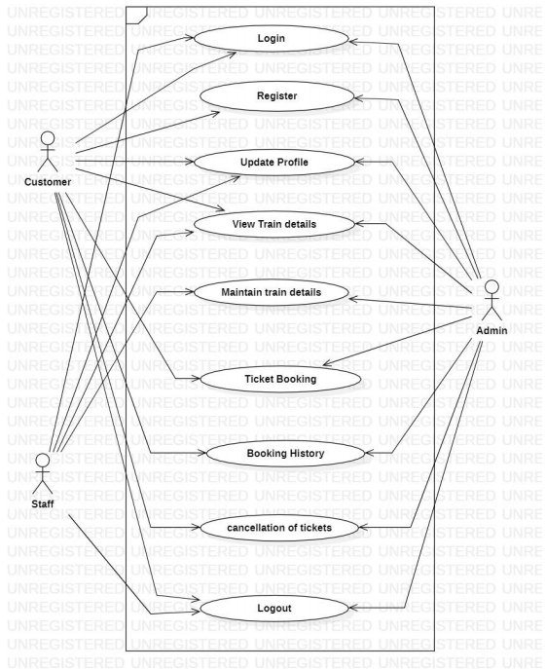
USE CASE DIAGRAM
ACTORS
Admin
Staff
Customer
USE CASES
Login
Register
Update profile
View train details
Maintain train details
Ticket booking
Booking history
Cancellation of tickets
Logout

Slide 5
Software Requirement Specification(SRS)
Overall Description
This section contains the details of product functionalities, hardware details which are discussed below. It also contains the detailed product perspective from different Stakeholders. The RRS help customers, admin, and staff to login in to the system. The RRS help customers, admin to book a ticket, cancel a ticket, searching for available trains on different routes, their booking history and brings/save the same data to/from the system. The RRS calculates total payment to pay for ticket booking and give various payment options to pay for the same. RRS also calculate refund amount in case of cancellation of ticket.
The admin will maintain details of the following:
Customers
Customer’s booking history
Staff
Train
The staff will perform the following functions:
Login to the system
Maintain train details
View Train details
Updating their personal profiles
Logout from the system

Slide 6
The Customer will perform the following functions:
Login to the system
Book a ticket
Cancel a ticket
View a train on a specific route
View booking history
Updating their personal profiles
Logout from the system
The Admin will perform the following functions:
Login to the system
Book a ticket
Cancel a ticket
Maintain train details
View a train on a specific route
View booking histories of customer
Add new customer and staff
Updating existing customer and staff profiles
Logout from the system
User Interfaces
The RRS will have the following user-friendly and menu-driven interfaces:
a) Login
b) Register
c) View Train Details
d) Book ticket
e) Booking history
f) Cancel ticket
g) Profile details
h) Maintain Train Details
i) Logout
Hardware Interfaces
Screen Resolution of at least 640 * 480 or above.
Support for printer.
Computer systems will be in the networked environment as it is a multi-user system
Software Interfaces
It can run on any Operating system.
HTML, CSS, JavaScript, Bootstrap for designing front end.
PHP and MySQL for designing the back end.

Slide 7
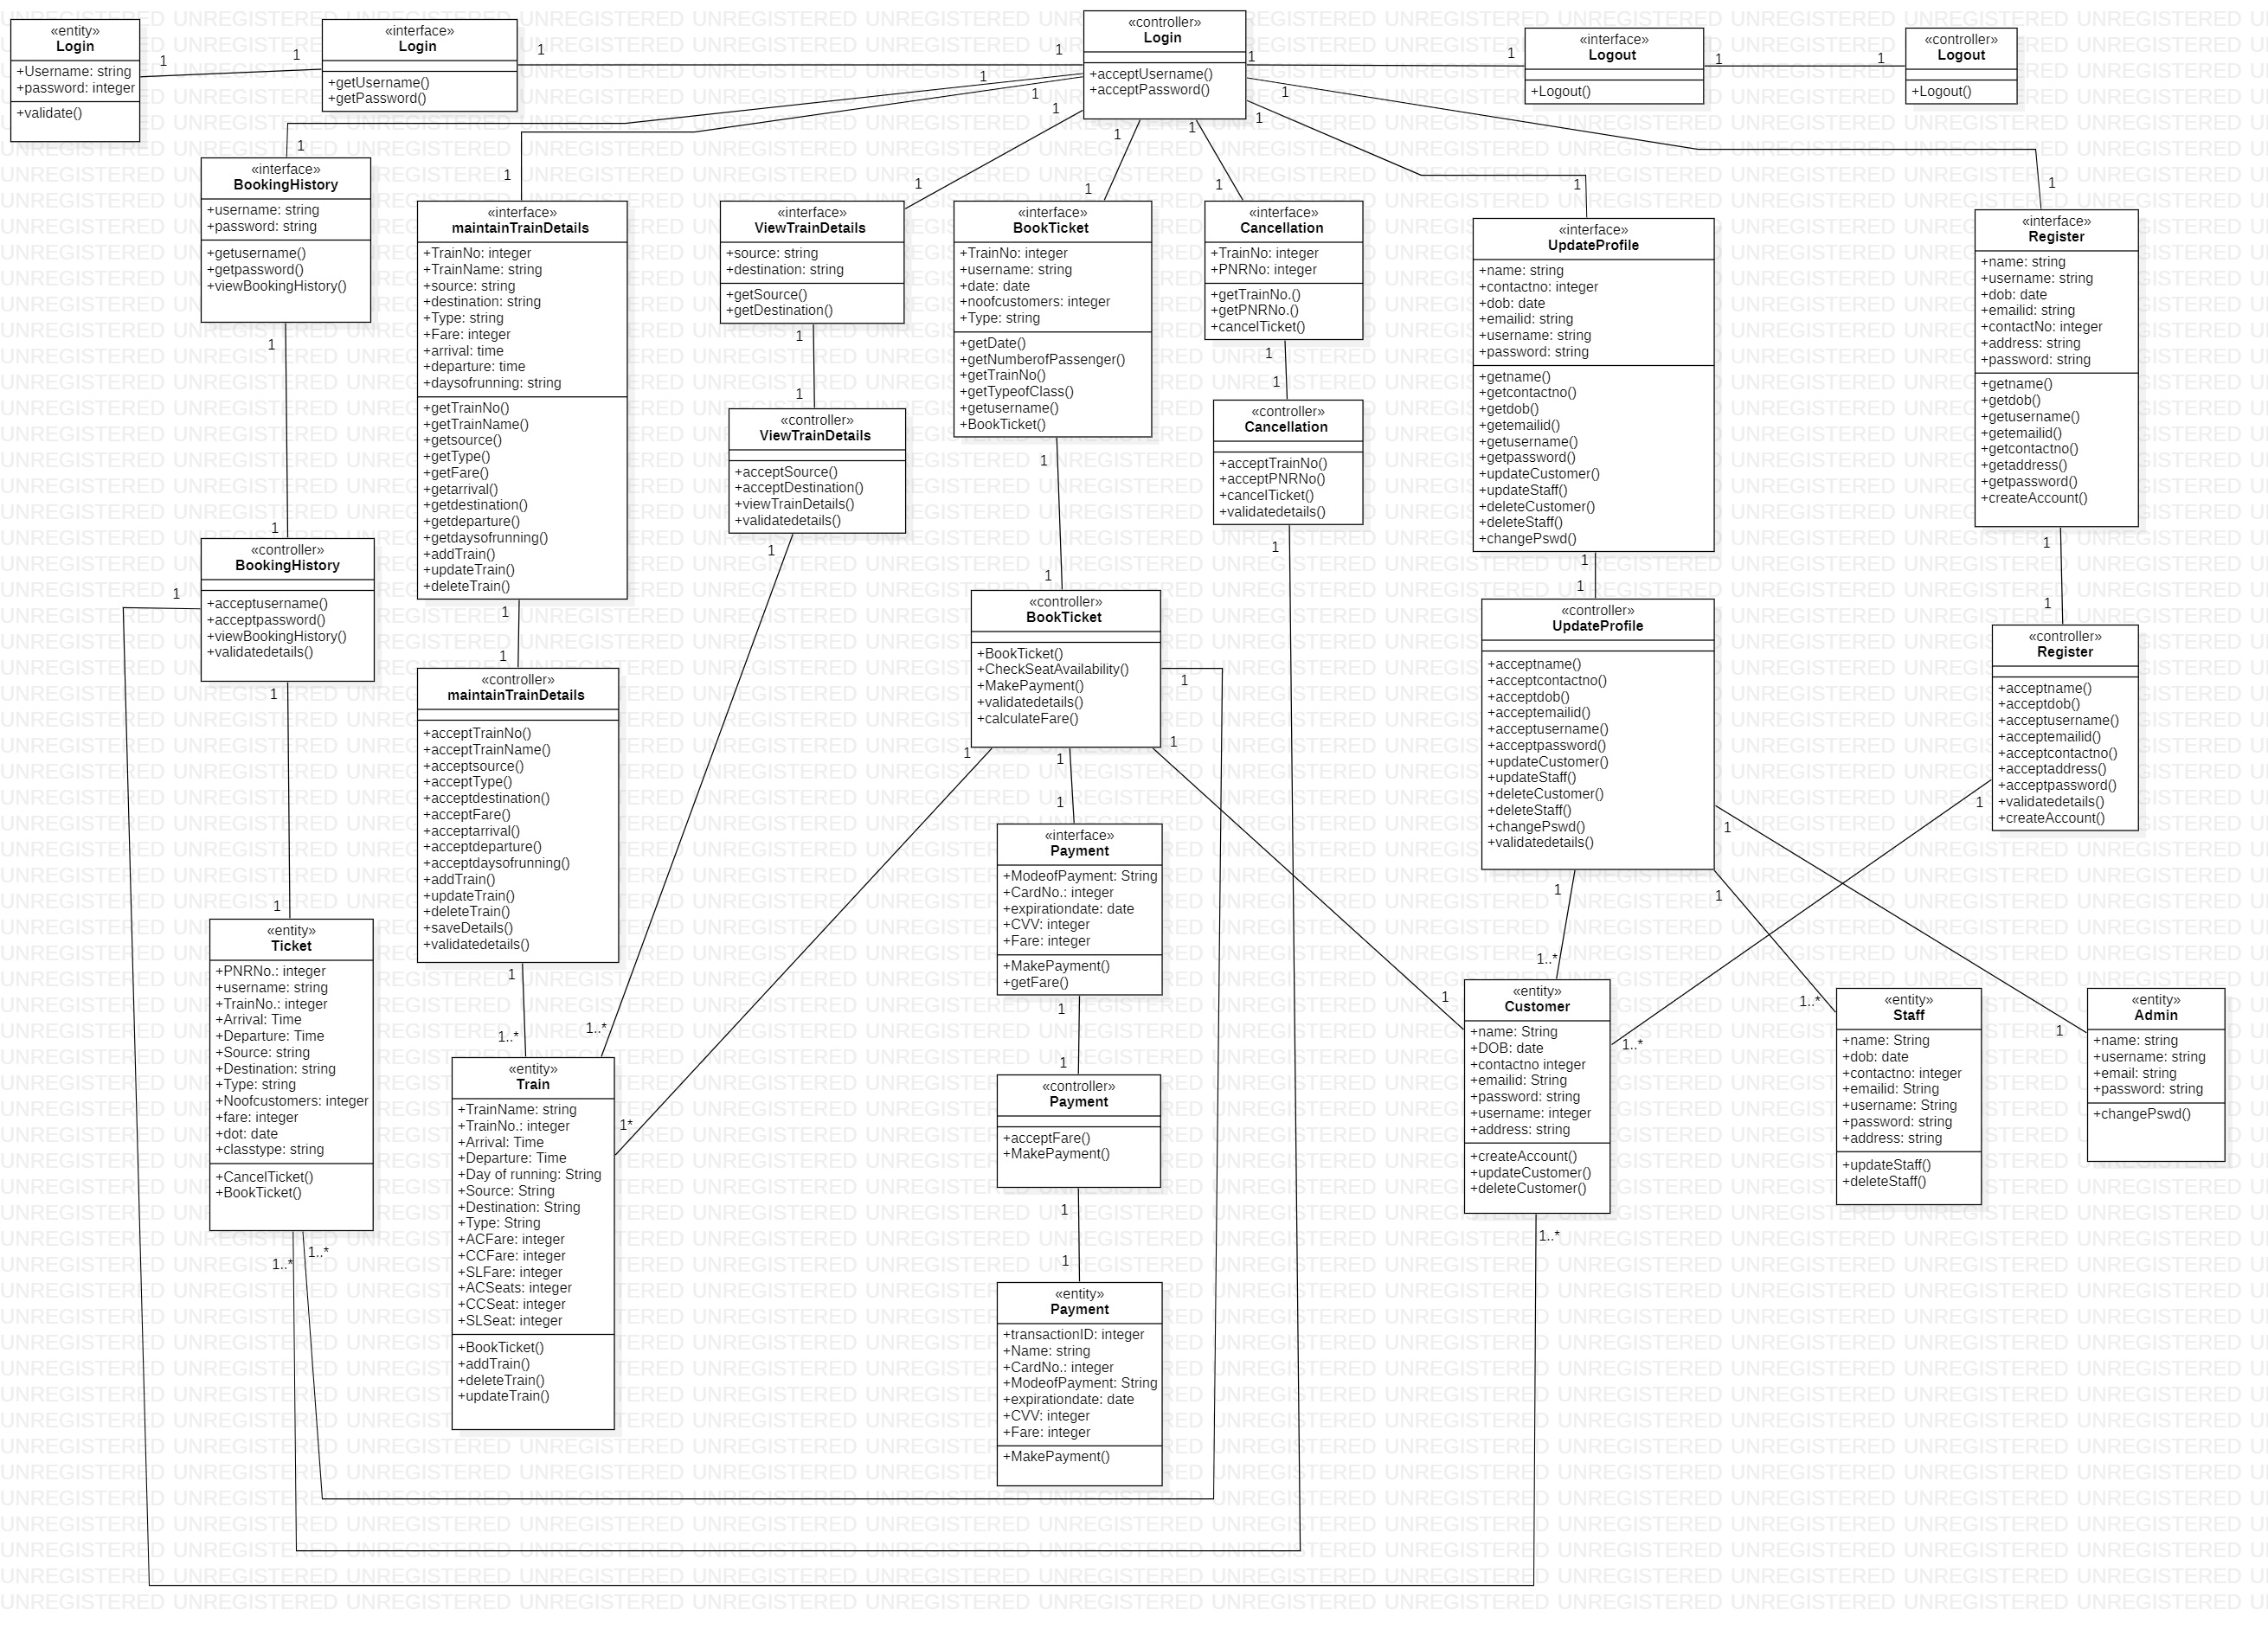
CLASS DIAGRAM

Slide 8
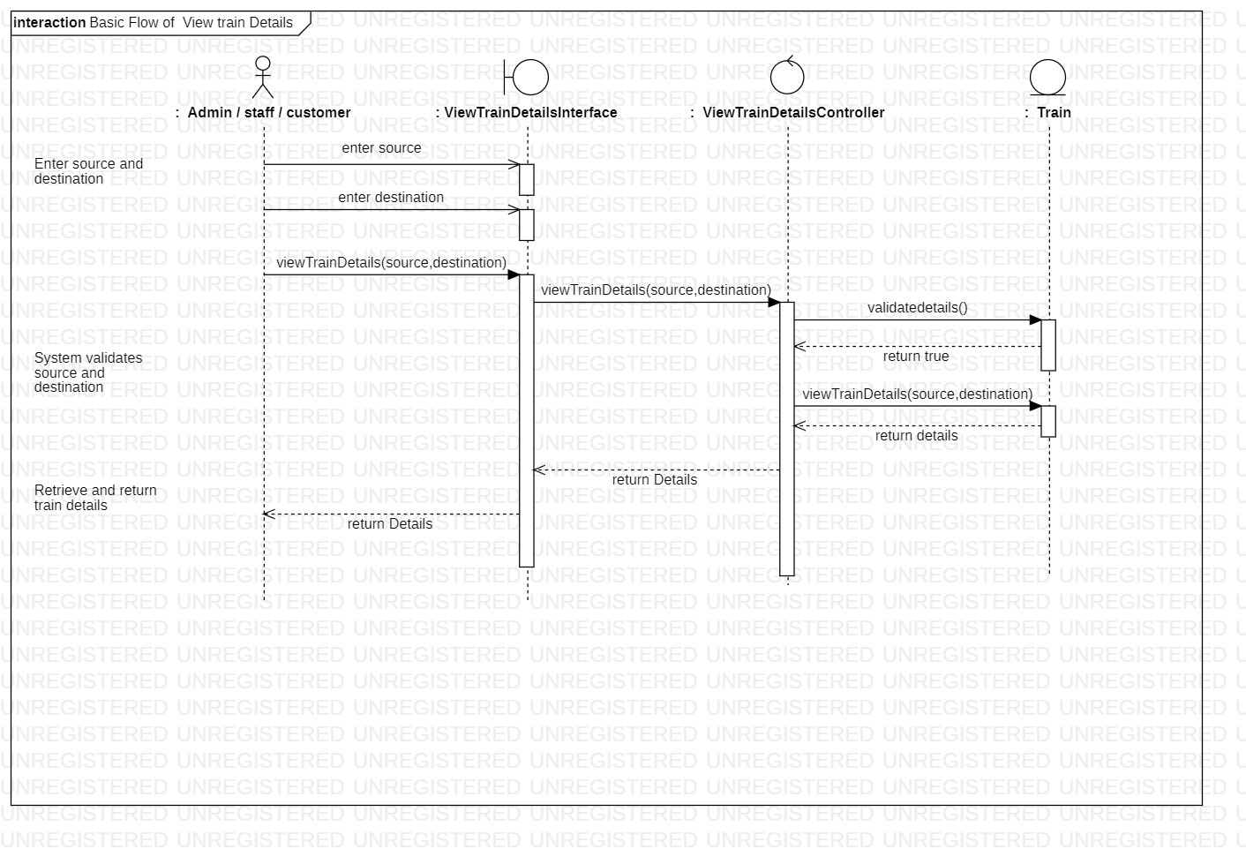
SEQUENCE DIAGRAM
VIEW TRAIN DETAILS BASIC FLOW

Slide 9
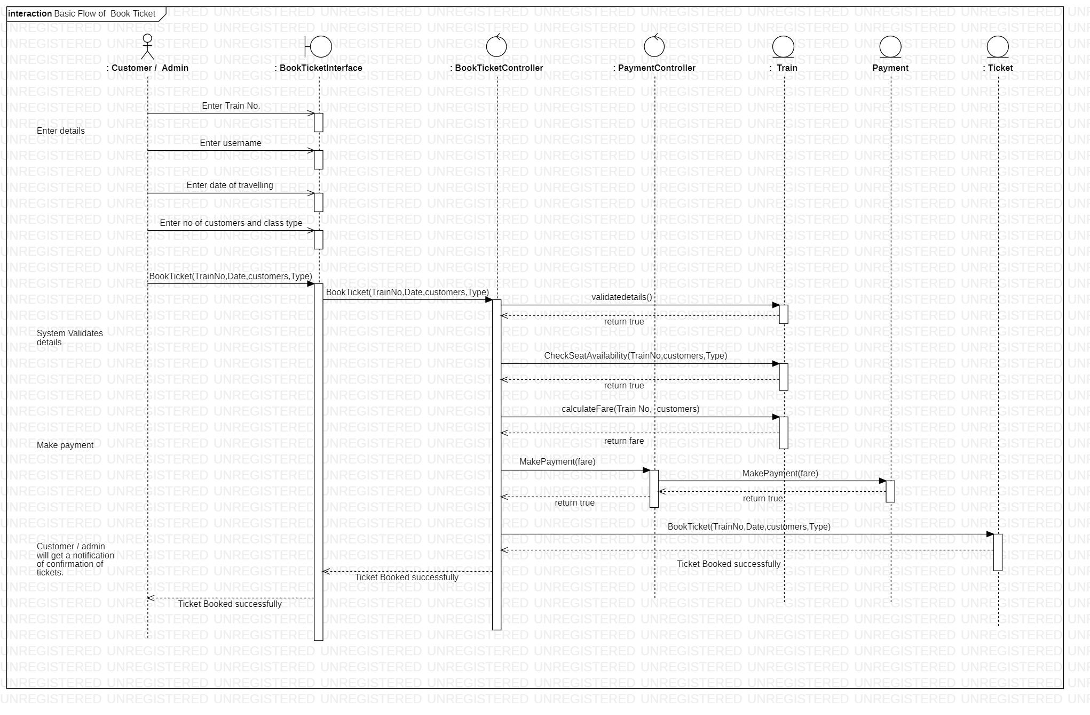
SEQUENCE DIAGRAM
BOOK TICKET BASIC FLOW

Slide 10
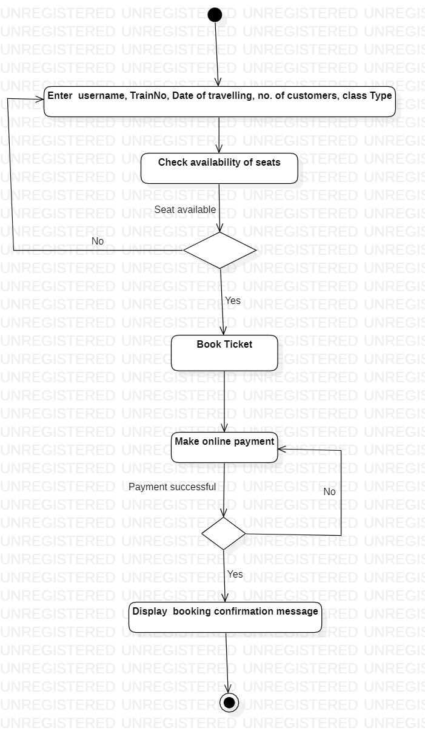
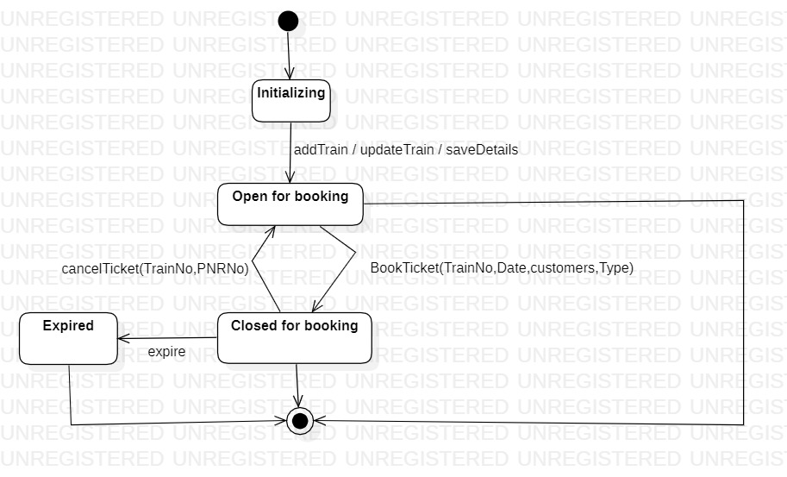
Ticket Booking
ACTIVITY DIAGRAM STATE CHART DIAGRAM
Ticket object

Slide 11
TEST CASE MATRICES
Test case ID | Scenario name and description | Input 1 From station | Input 2 To station | Expected output | Remarks
TC1 | Scenario 1- Basic flow View train details | Valid input | Valid input | View train details successfully | -
TC2 | Scenario 2- View train details Alternate flow: Invalid details | Invalid input | Valid / Invalid input | From station is invalid | From station is not in specified format
TC3 |  | Valid input | Invalid input | To station is invalid | To station is not in specified format
TC4 | Scenario 3- View train details Alternate flow: Actor exits | Valid / Invalid input | Valid / Invalid input | Actor exits and return to homepage | -
VIEW TRAIN DETAILS

